Slide 1
Install R and RStudio on your bureau laptop
Note you will first install R, then you will install RStudio:
Install R
Install RStudio
Submit Remedy request: Digital Workplace (census.gov) - Application Request

Slide 2
Submit Remedy Request for R and RStudio
Go to Remedy: Digital Workplace (census.gov) , search for ‘Application Request’
And select ‘Request Now’ to request both R and RStudio to be delivered to your laptop’s Software Center.

Slide 3
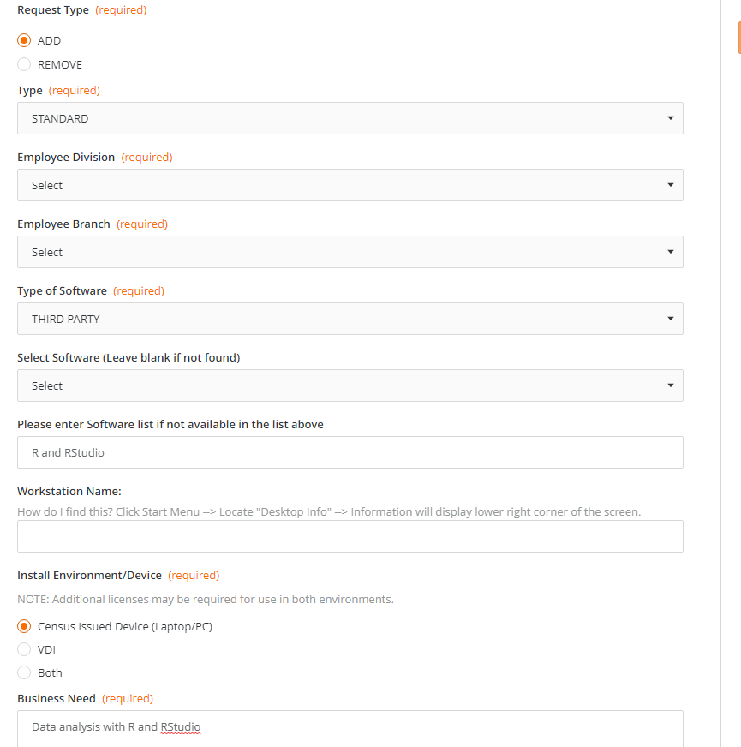
Fill out Remedy Application Request
Request Type: Add
Employee Division, Branch – Select from drop down
Type of Software: Third Party
Please enter Software list is not available in the list above: R and RStudio
Workstation Name: (see How do I find this? in form)
Install Environment/Device:
Census Issued (Laptop/PC)
Business Need: R and RStudio, hands-on workshop
You are now ready to ‘Submit Request’
You will receive emails confirming your request and that R and RStudio will be associated with your laptop’s Software Center.

Slide 4
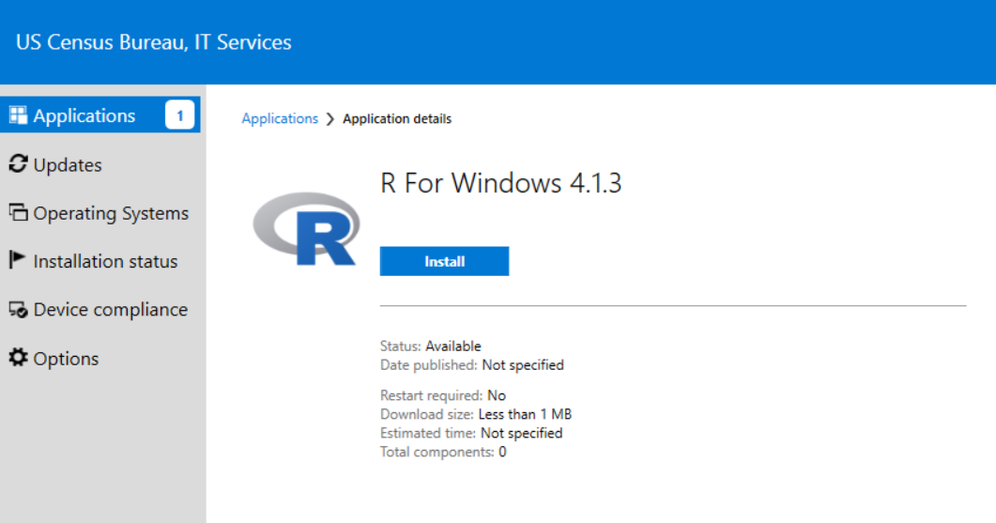
First install: R for Windows

Slide 5
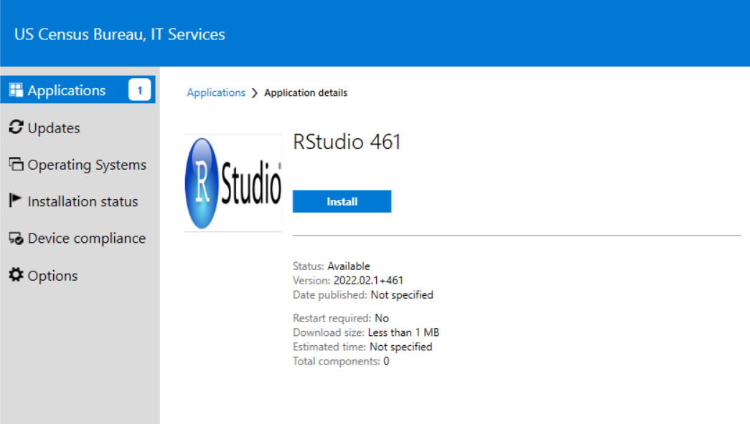
After R is installed, install: RStudio

Slide 6
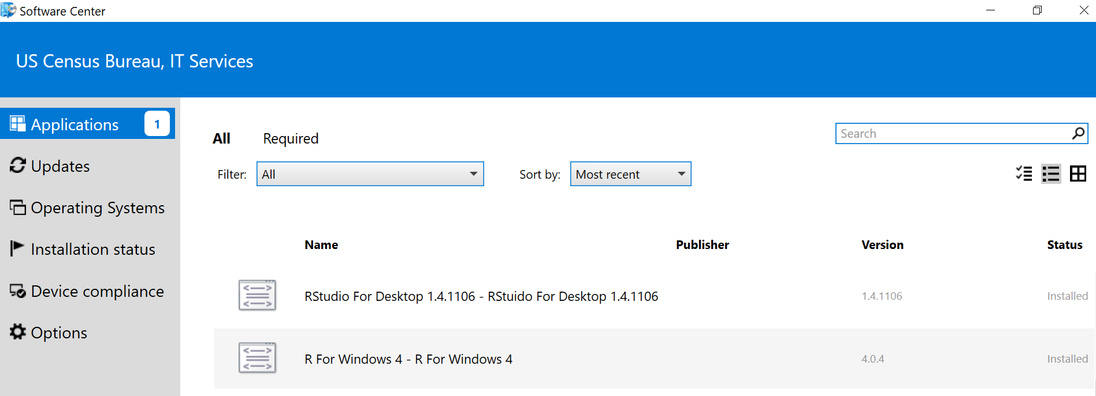
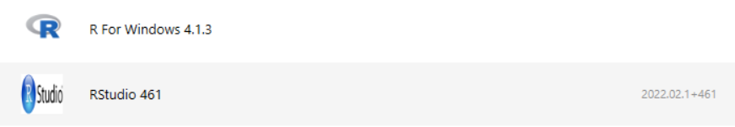
Software Center will then show Status: Installed

Slide 7
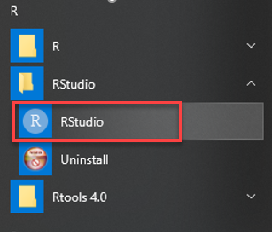
Application will appear on start menu. To confirm successful application, open RStudio and try the following exercise:
First R script | Hello World | RStudio | R 3.3 - YouTube

Slide 8
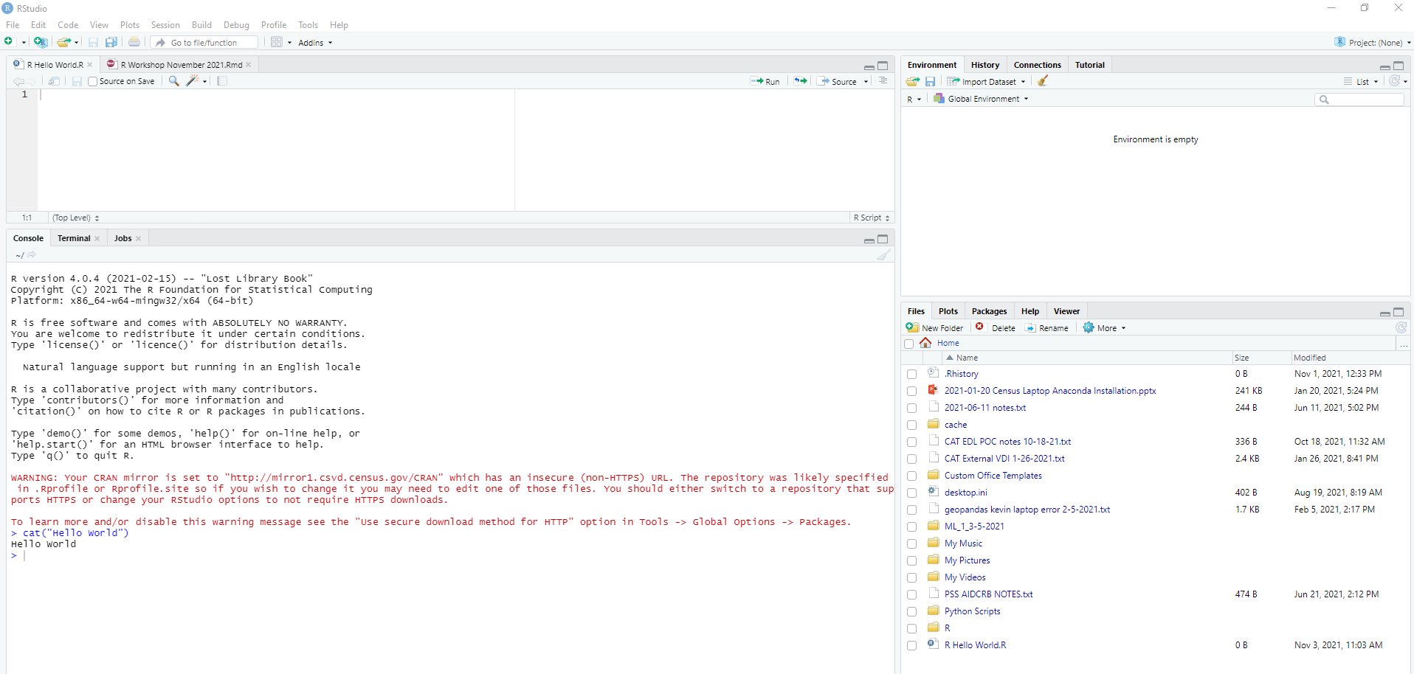
RStudio – “Hello World”

